Slide 1
React Native
ReactJS for mobile applications
Satvik Jagannath
Software Development Engineer,
CISCO

Slide 2
ReactJS
by Facebook
in 2013
Facebook, Instagram, Airbnb, Wordpress, Automattic, BBC, Flipkart, Myntra, Facebook Ads app, Box, Coursera, Dropbox, Dailymotion, Flipboard, IMDB, Hipchat, Khan Academy, Netflix, OkCupid, Paypal, Quizup, Reddit, Salesforce, Whatsapp, Wired, Yahoo, Atom Editor, Brackets Editor, Firefox Hello etc.,
100’s of others - Facebook Github

Slide 3


Slide 4
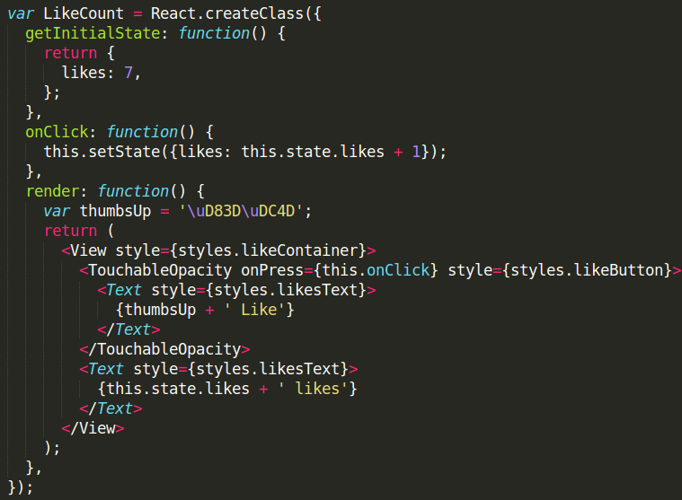
Hello ReactJS
UGLY?
Templating language!!
Separation of Concerns
-_-

Slide 5
Hello ReactJS
It’s just Javascript
JSX Syntax
You better like it ;)

Slide 6
Hello ReactJS
2 way binding like Angular?
Models? Controllers?
Where is directives?
Global Event listener?
Templates?...
Works with Backbone?
Can I also use jQuery? ;)
I know jQuery, not JS!
is this JS?

Slide 7


Slide 8
React has no
Controllers

Slide 9
React has no
Controllers
Directives

Slide 10
React has no
Controllers
Directives
Templates

Slide 11
React has no
Controllers
Directives
Templates
Global Event Listener

Slide 12
React has no
Controllers
Directives
Templates
Global Event Listener
Models

Slide 13
React has no
Controllers
Directives
Templates
Global Event Listener
Models
View-Models

Slide 14
React has no
Controllers
Directives
Templates
Global Event Listener
Models
View-Models
Blah
Blah Blah
Blah Blah Blah

Slide 15
React has
COMPONENTS

Slide 16
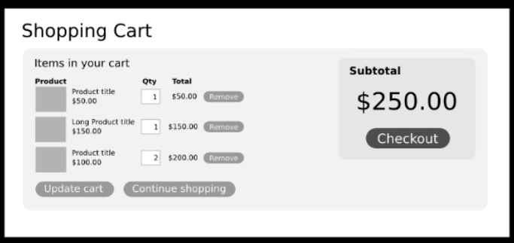
How do you separate concerns?

Slide 17
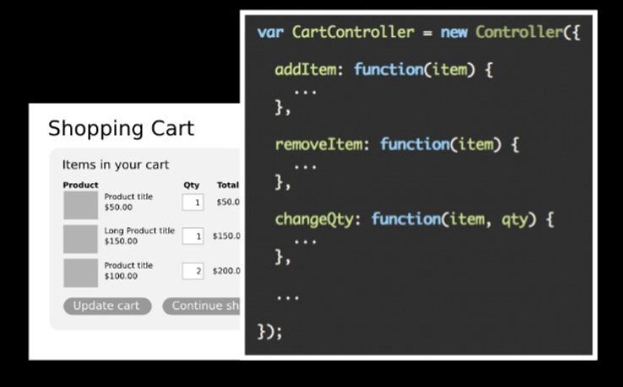
Angular - Separation.

Slide 18
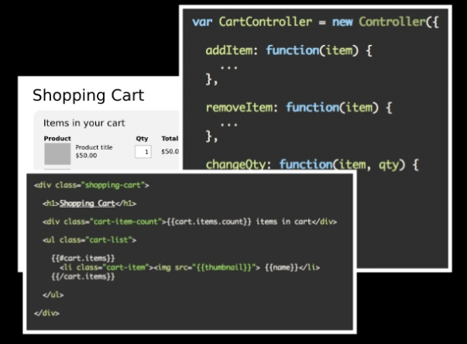
Ember Separation ..

Slide 19
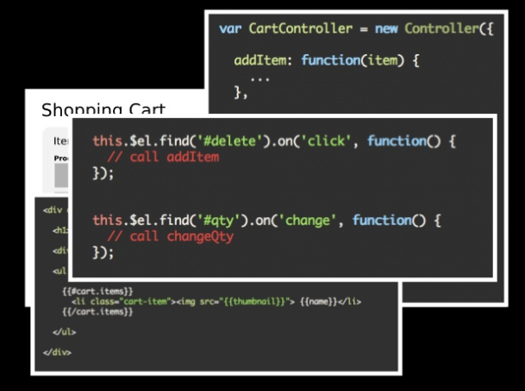
Backbone Separation...

Slide 20
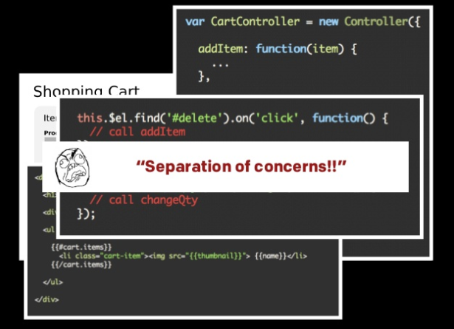

Slide 21
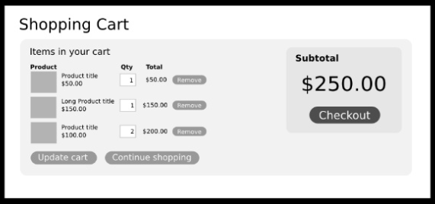
What if we Separate in ANOTHER way?

Slide 22
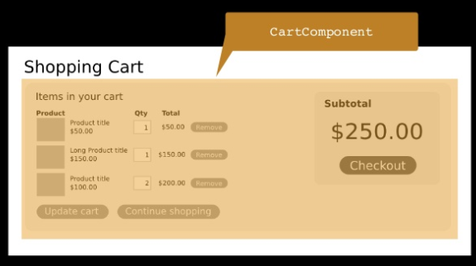
What if we Separate in ANOTHER way?

Slide 23
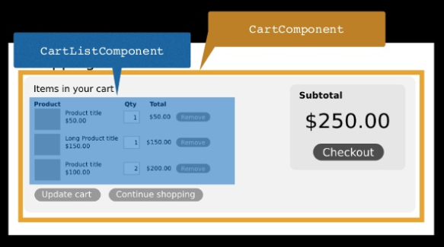
What if we Separate in ANOTHER way?

Slide 24
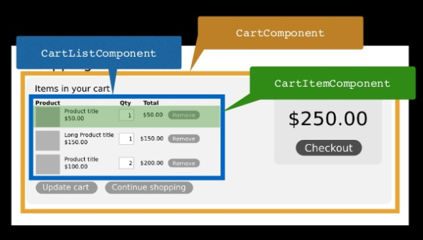
What if we Separate in ANOTHER way?

Slide 25
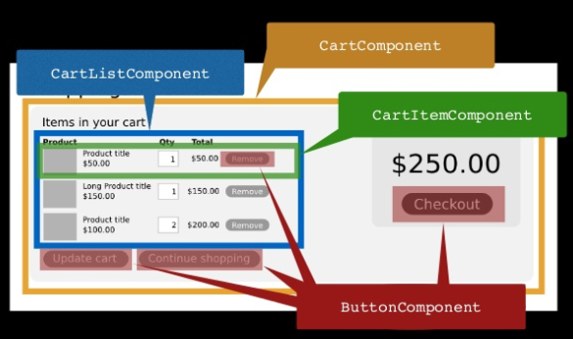
What if we Separate in ANOTHER way?

Slide 26

Yay baby!

Slide 27
Separation of Components!
Composable
Reusable
Maintainable
Testable
IF AND ONLY IF, components are self-contained.

Slide 28
Data flow
Pure JS - Any component can communicate with any other component
Backbone - Publisher Subscriber model
item.on(‘change:name’, function() { ...
Angular - 2 way data binding & $digest loop
$scope.name = …
React - 1 way data “FLOW”

Slide 29

One Way data FLOW sounds GREAT!
That’s NOT how real world works!

Slide 30
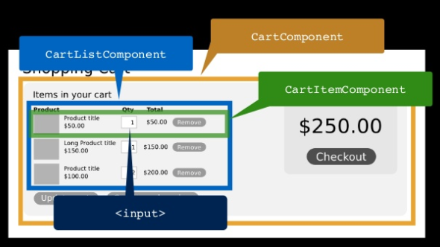

Slide 31
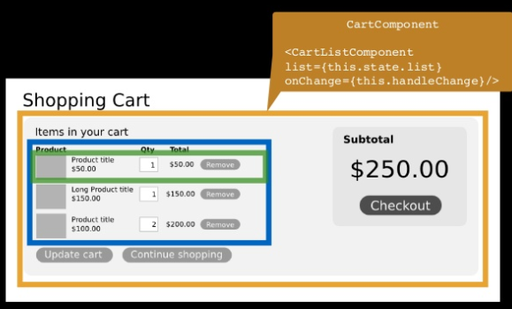
Data flows DOWN with handlers

Slide 32
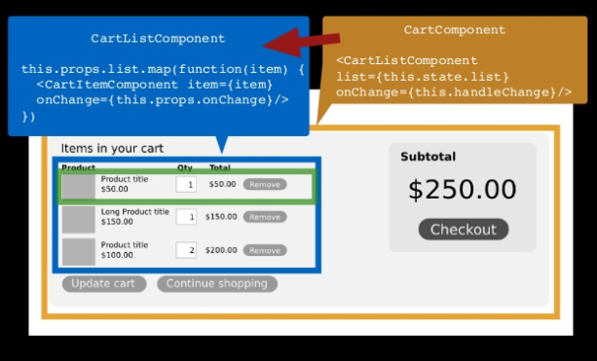
Data flows DOWN with handlers

Slide 33
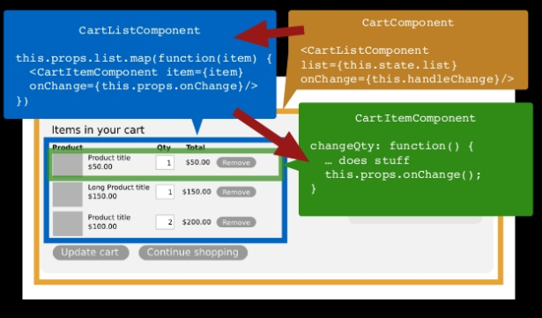
Data flows DOWN with handlers

Slide 34
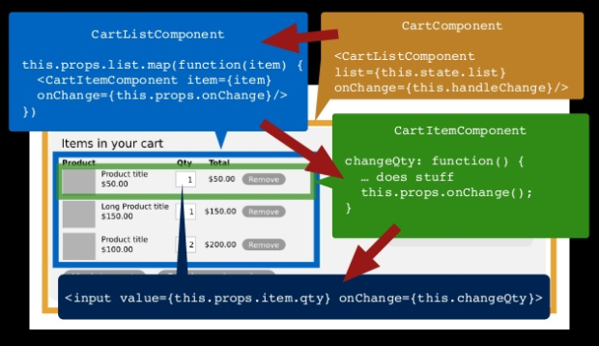
Data flows DOWN with handlers

Slide 35
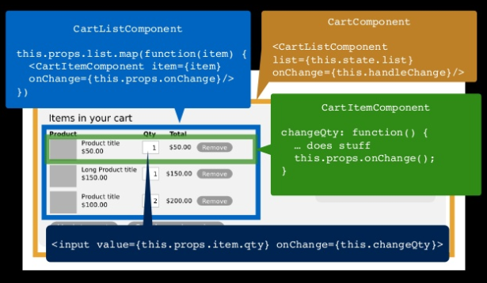
Here we gooooooo

Slide 36
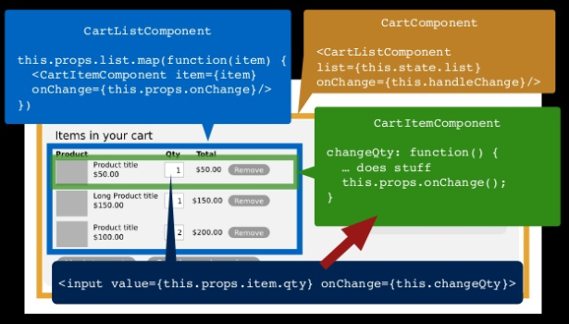
Event Flows UP

Slide 37
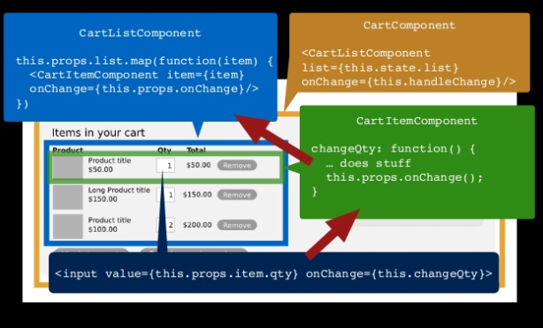
Event Flows UP

Slide 38
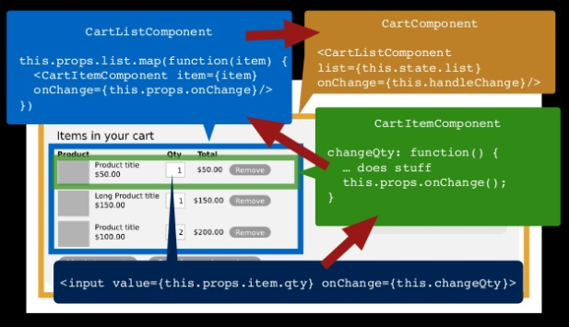
Event Flows UP

Slide 39
Data flows DOWN
Event Flows UP
Sounds familiar?

Slide 40
Data flows DOWN
Event Flows UP
That’s how DOM works!

Slide 41
Virtual DOM
React uses Virtual DOM
2 DOM’s will co-exist - Real and Virtual
What worse that having 2 DOM’s? Having 1 DOM!
Why not DOM?
Inconsistent
Hard to test
Brittle
Expensive operation

Slide 42
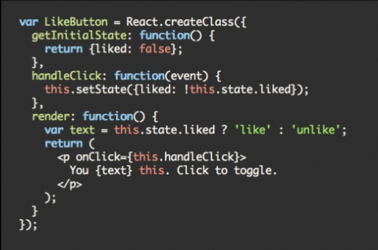
Back to JSX

Slide 43
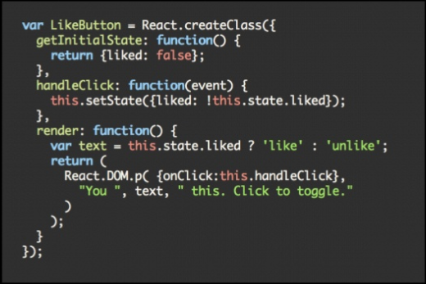
Compiled JSX

Slide 44
Virtual DOM
Pure JS, in-memory representation of DOM
render() fires when there is a change in state
React takes care of modifying the Real DOM to match the Virtual DOM
It’s fast
It’s pure
It just works

Slide 45
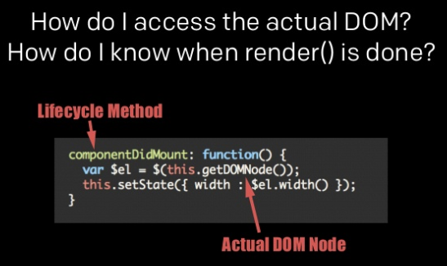
Virtual DOM - How’s?

Slide 46
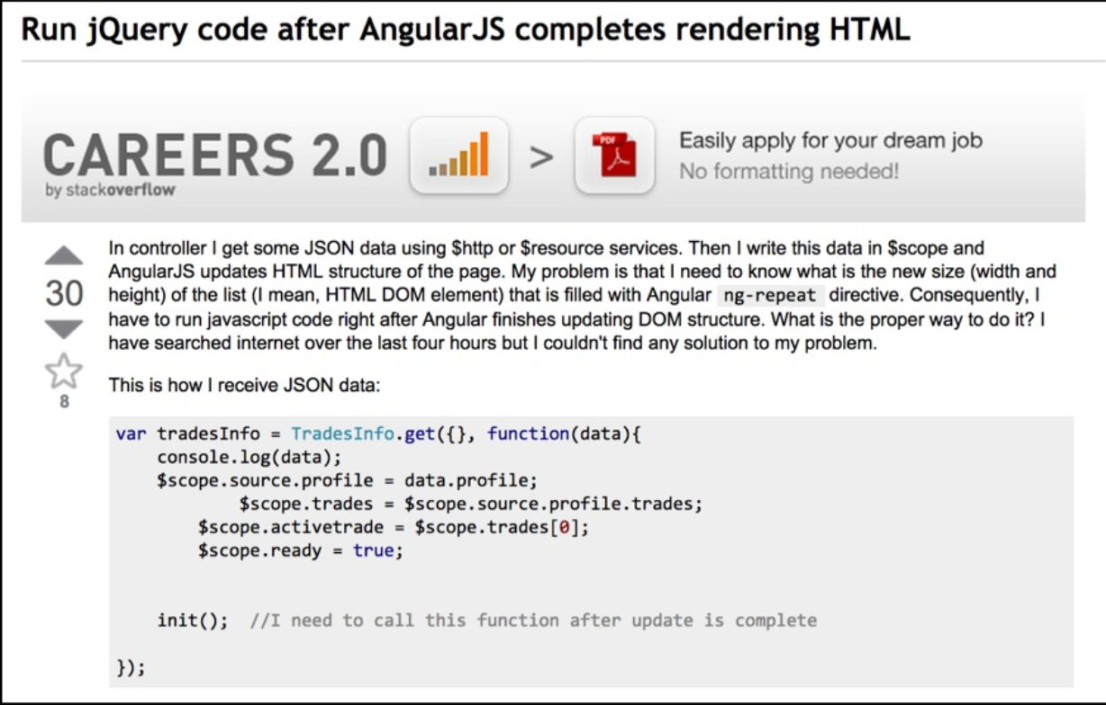
Declarative Syntax

Slide 47
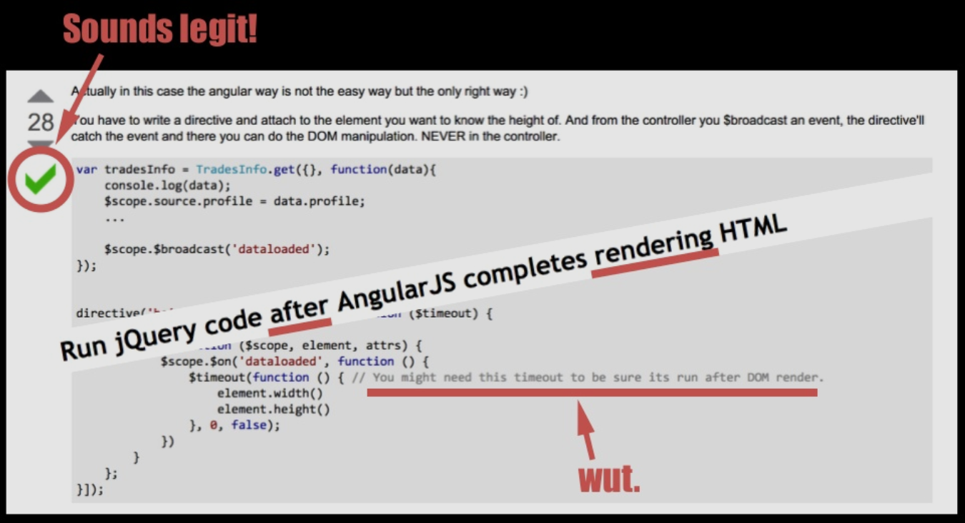

Slide 48
Why React is awesome?
One way dataflow keeps complexity under-control
You really know this changed because of that! Blame game!
Easy to debug - Self contained components
Library doesn’t dictate too much!
Simple and easy to learn

